Slide 1

TELECOM
CHURN
ANALYSIS

Slide 2

What is Churn?
Telecom Customer Churn refers to the phenomenon where customers stop using one telecom service provider and switch to another or discontinue services altogether .Customers who left within the last month – the column is called Churn
Example of Churn in Telecom:
Ravi is a customer of Provider A but faces frequent call drops and slow internet speeds. He notices that Provider B offers better coverage and a cheaper plan with more data. Dissatisfied, Ravi switches his number from Provider A to Provider B using Mobile Number Portability (MNP).

Slide 3
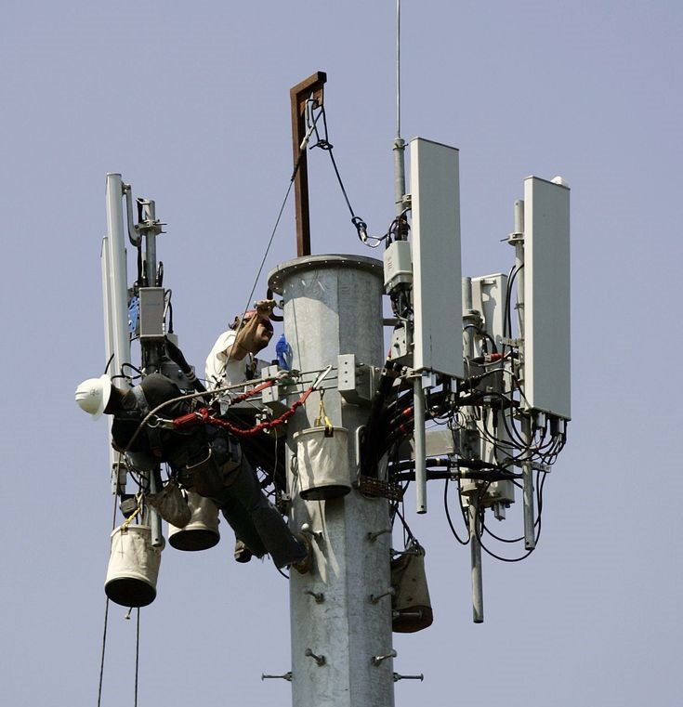
About Telecom Churn Analysis
名古屋市
NAGOYA
The primary objective of this analysis is to identify the factors contributing to customer churn and build a predictive model to classify customers as churners or non-churners. The insights derived will help the telecom company implement targeted retention strategies to minimize churn and improve customer satisfaction.
The data was downloaded from IBM Sample Data Sets for customer retention programs. The goal of this project is to predict behaviours of churn or not churn to help retain customers. Each row represents a customer, each column contains a customer’s attribute.
Nagoya is the largest city in the Chubu region, the fourth-most populous city and third most populous urban area in Japan, with a population of 2.3 million in 2020. It is one of the three major cities of Japan (Tokyo-Osaka-Nagoya). Located on the Pacific coast in central Honshu, it is the capital and the most populous city of Aichi Prefecture.
Population
2.3M

Slide 4
1. Demographic Variables
These describe the customer's personal details
2. Services Variables
These describe the telecom services subscribed to by the customer.
3. Account Variables
These describe the customer's account details.
4. Target Variable
This variable indicates whether the customer has churned.
Data description
The telecom dataset has 7043 rows and 21 columns
Demographic Variables
Gender
Senior Citizen
Partner
Dependents
Services Variables
Phone Service
Multiple Lines
Internet Service.
Online Security
Online Backup
Device Protection
Tech Support
Streaming TV
Streaming Movies
Account Variables
Contract
Paperless Billing
Payment Method
Monthly Charges
Total Charges
Tenure
Target Variables
Churn

Slide 5
Categorical Variable
Numerical Variable
Gender
Partner
Dependents
Phone Service
Multiple Lines
Internet Service
Online Security
Online Backup
Device Protection
Tech Support
Streaming TV
Streaming Movies
Contract
Paperless Billing
Payment Method
Churn
Senior Citizen
Monthly Charges
Total Charges
Tenure

Slide 6


Exploratory Data Analysis
When you first get your data, it’s very tempting to immediately begin fitting models and assessing how they perform. However, before you begin modeling, it’s absolutely essential to explore the structure of the data and the relationships between the variables in the data set.
Do a detailed EDA of the data set, to learn about the structure of the data and the relationships between the variables in the data set (refer to Data description sheet of data). Your EDA should involve creating and reviewing many plots/graphs and considering the patterns and relationships you see.

Slide 7
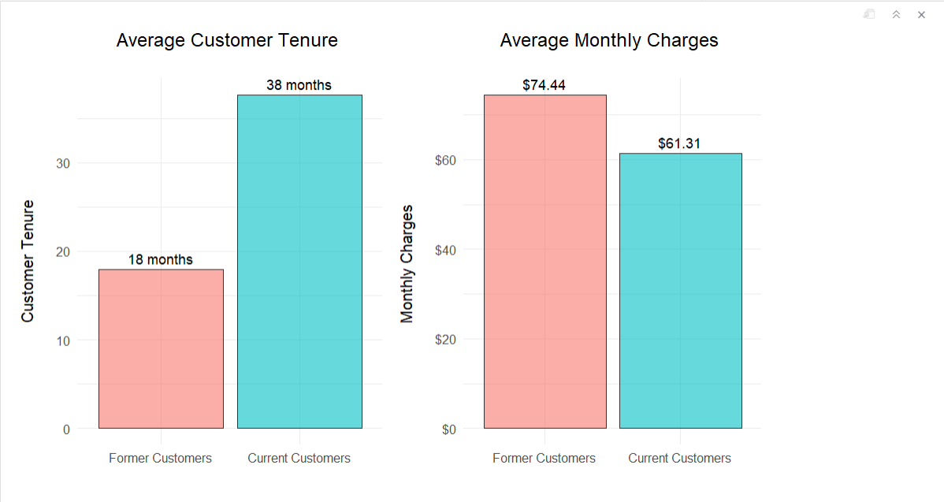
Customer's average tenure with Telecom and their average charges

Slide 8
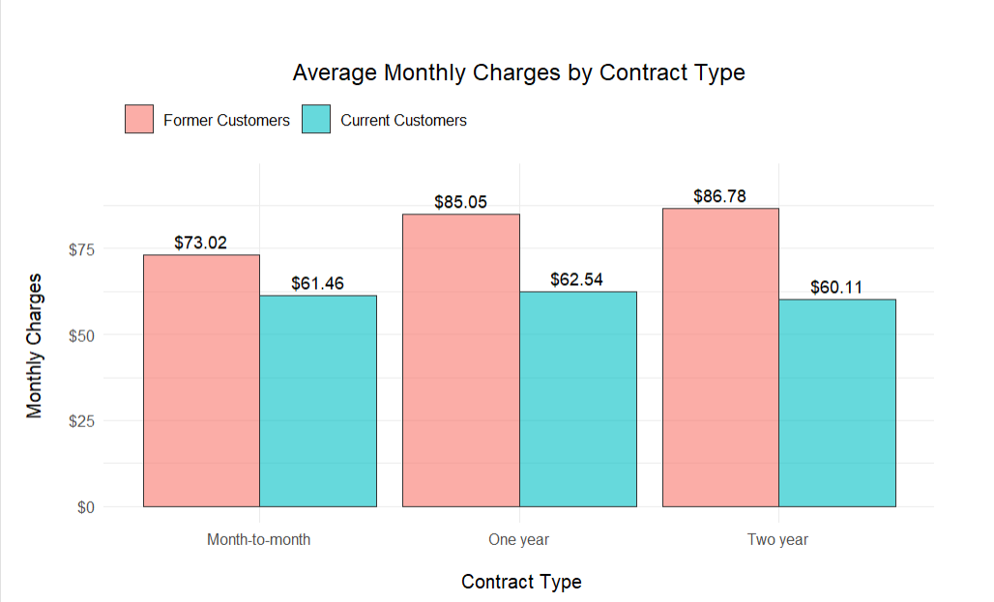
Average Monthly Charges by Contract Type

Slide 9
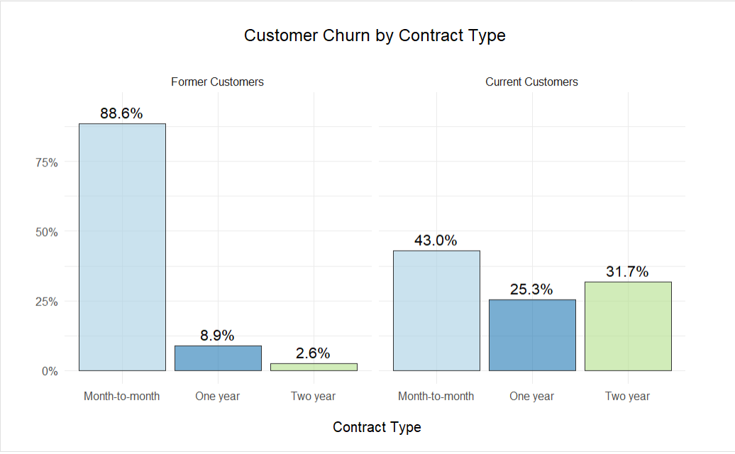
Customer churn by contract type

Slide 10
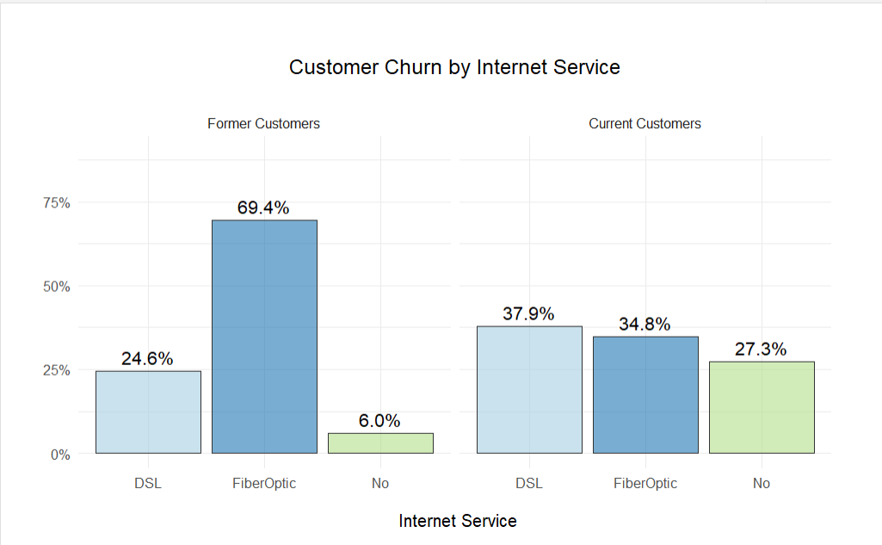
Customer churn by internet service

Slide 11
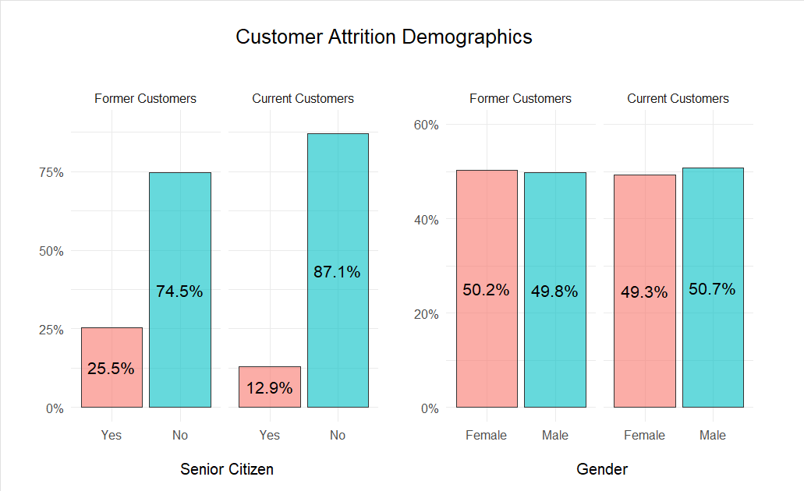
Customer Attrition Demographics

Slide 12
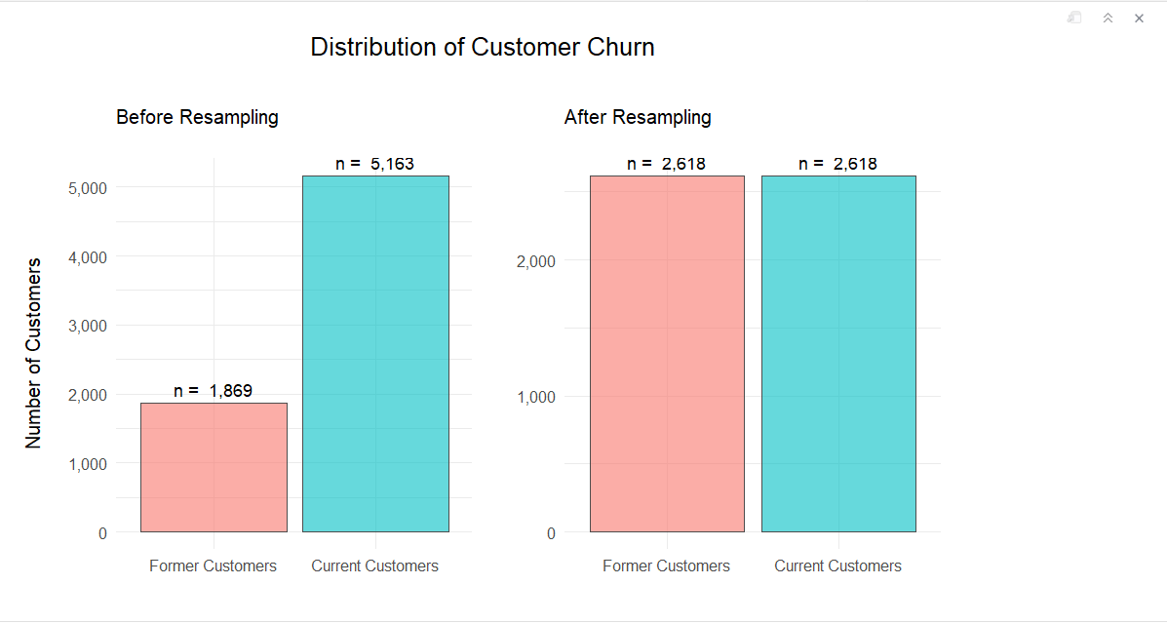
SMOTE for Churn Balance
Churn data was imbalanced (only ~26% churned).
Used Synthetic Minority Over-sampling Technique (SMOTE) to balance classes for better model training.
Created synthetic churner cases using nearest neighbors.
Balanced dataset improved recall, helping models detect churners accurately.

Slide 13
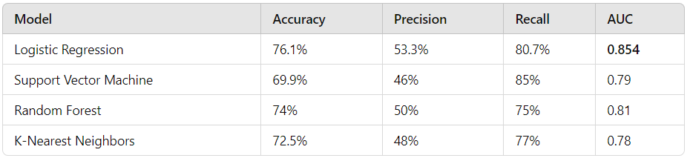
Model Performance
Best Model: Logistic Regression due to the highest AUC and balanced performance.

Slide 14
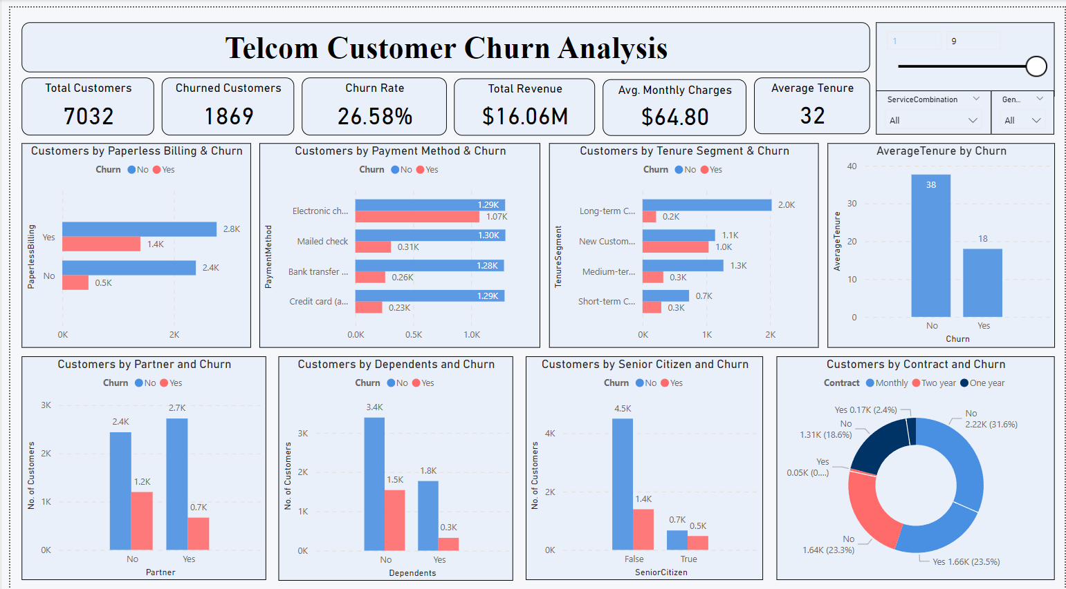

Slide 15
